Slide 1
Engineering Mechanics Course code: 116U06C104
Module 1: System of Forces
1.1: System of coplanar forces
Faculty: Dr. Manish Deo

Slide 2
Learning Outcome
Students will be able to calculate the resultant of
Coplanar concurrent force system
Students will be able to calculate the moment of
force about a point.
Students will be able to apply Varignon’s
theorem

Slide 3

Mechanics Definition and Classification
Definition
The branch of physical science which is concerned with study of resultant, effect of action of force on bodies, both in the state of rest and in motion.^{[14]}
Classification
Mechanics of rigid bodies
Mechanics of deformable bodies
Mechanics of fluids (Fluid Mechanics)

Slide 4
Rigid Body Mechanics
In rigid body mechanics, bodies are assumed to be perfectly rigid, i.e. there is no deformation of bodies under the action of loads to which they are subjected.
Although Engineering machines and structures do deform under the action of loads, their deformation is so little, that it does not affect the conditions of equilibrium or equations of motion which are applied in their study.

Slide 5
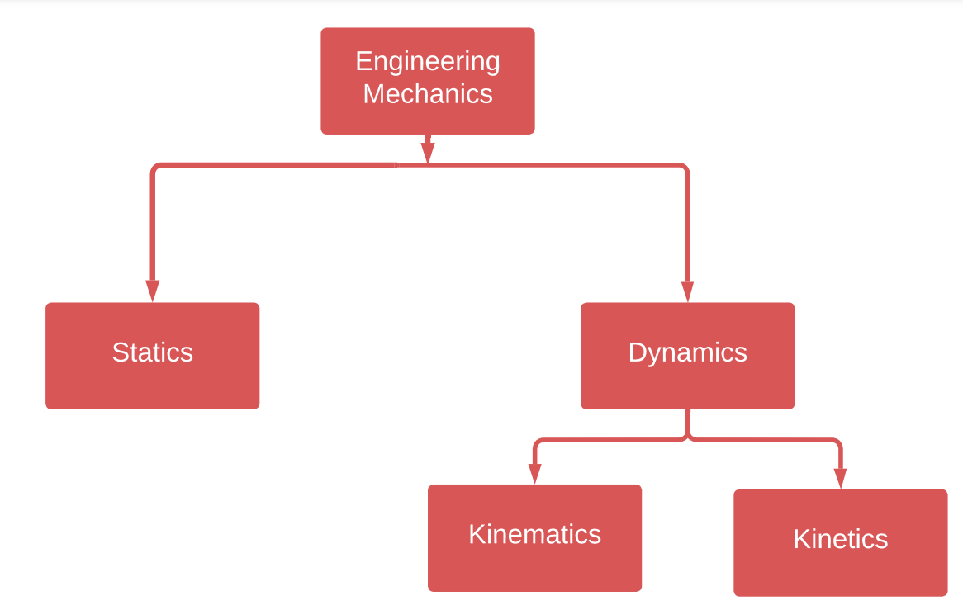
Mechanics of Rigid Bodies (Engineering Mechanics) Classification

Slide 6
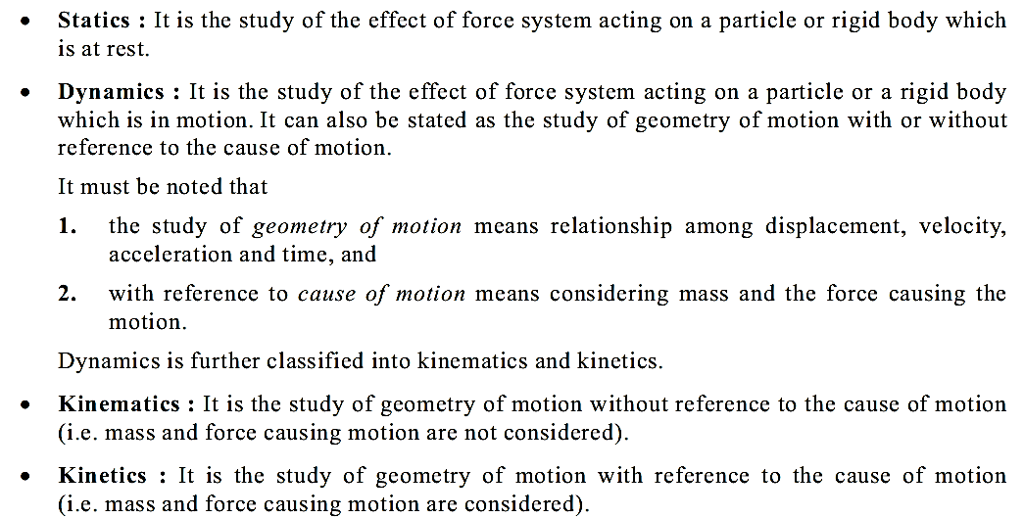
Engineering Mechanics definitions

Slide 7
Fundamental Concepts of Mechanics
Length:
Position of a point in space w.r.t. origin.
Size of a system
Time:
For bodies in motion

Slide 8
Fundamental Concepts of Mechanics
Mass:
Quantity of matter contained in a body.
Remains unchanged irrespective of the position occupied by
the body.
Force:
Action of one body on the another body.
The action could be ‘push’ or ‘pull’.
The force is exerted when there is actual contact between the two bodies or without contact like: gravitational force or magnetic force etc.
Force requires: Magnitude, direction, point of application

Slide 9
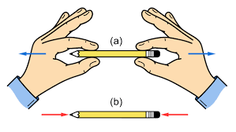
Pull – Push Force
PULL
PUSH
Fig. 1 Pull – Push forces^{[1]}

Slide 10
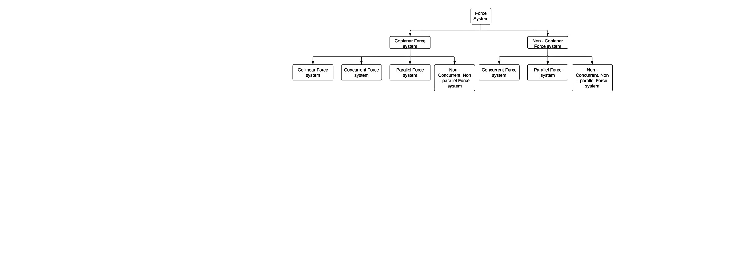
Classification of Force System
Fig. 2 Classification of Force system

Slide 11
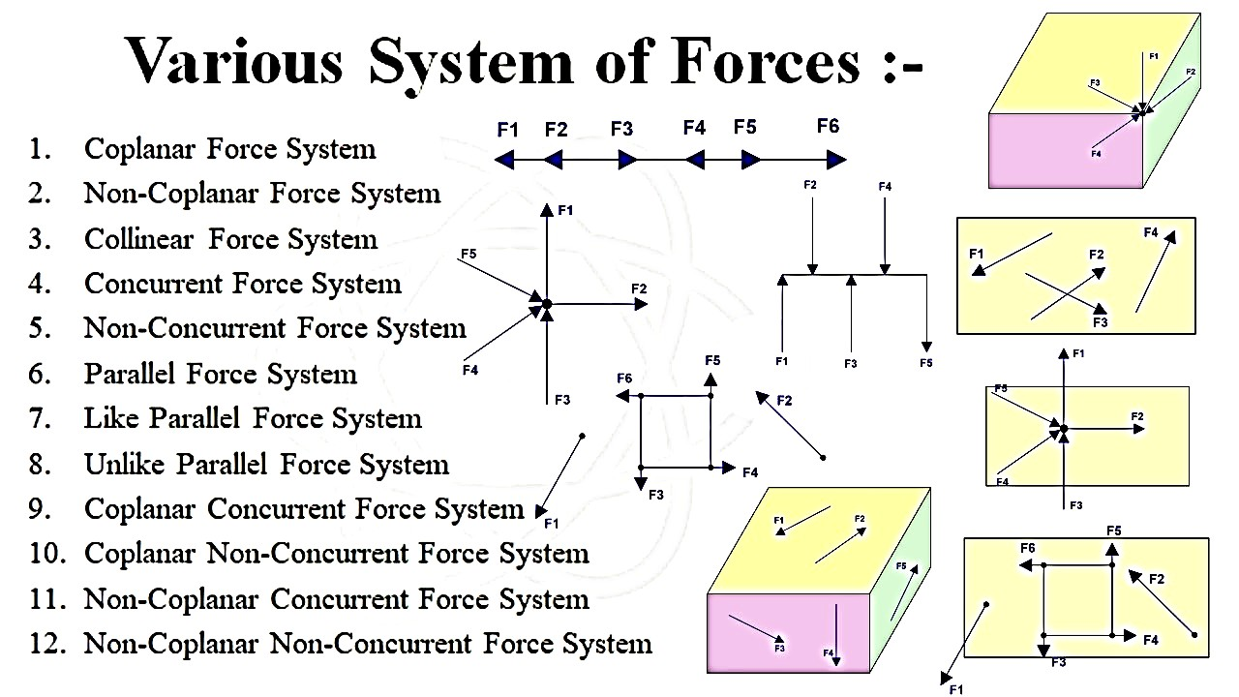
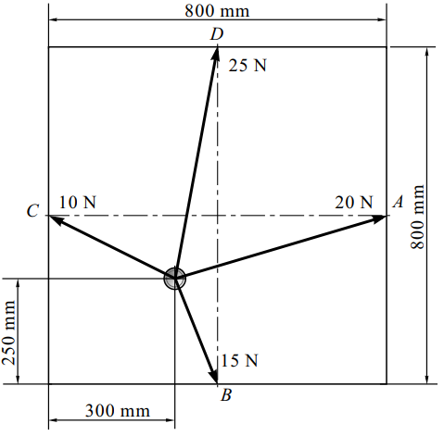
Fig. 2 Classification of Force system

Slide 12
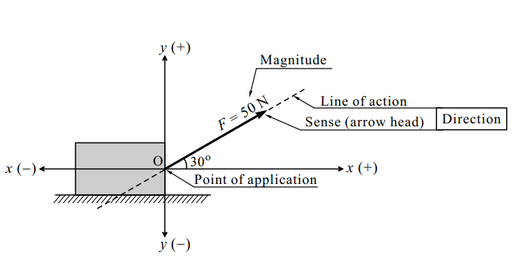
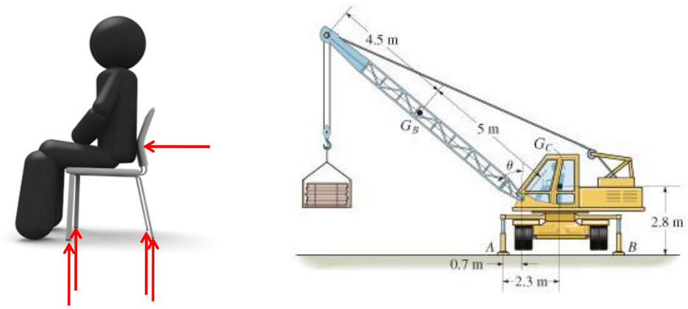
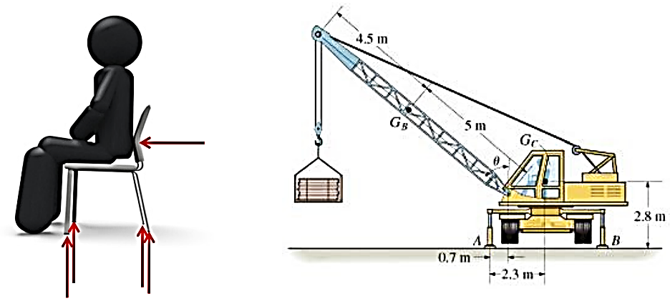
Force
Fig. 3 Force system^{[2]}

Slide 13
Particle and rigid body
Particle: It is a matter with considerable mass but negligible dimension.
Eg. Train, Artificial satellite
Rigid body: It is a matter with considerable mass as well as dimension.
Eg. Columns and beams of structure

Slide 14
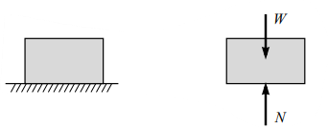
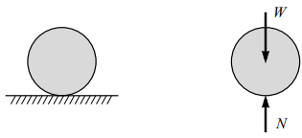
Point load
The load of a body at contact surface acting over a certain area, is assumed as acting at a point, for simplicity and calculation.
Fig. 4 A block kept on the floor^{[2]}
Fig. 5 A ball in contact with ground^{[2]}

Slide 15
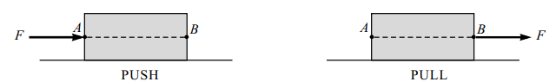
Principle of Transmissibility of force
According to the principle of transmissibility of force, the uniform motion of rigid body or the condition of equilibrium will remain unchanged if the point of application of a force acting on a rigid body is transmitted to act at any other point along its line of action.
Fig. 6 Push force conversion to pull force^{[2]}

Slide 16
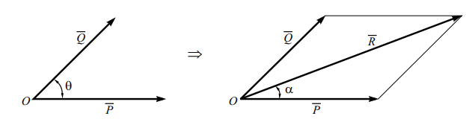
Law of parallelogram of force
According to this law,
if the two forces acting simultaneously on a body at a point are represented in magnitude and direction by two adjacent sides of a parallelogram, then their resultant is represented in magnitude and direction by the diagonal of parallelogram which passes through the point of intersection of the two sides representing the forces.
Fig. 7 Law of parallelogram of force^{[2]}

Slide 17
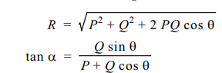
Law of parallelogram of force
Fig. 7 Law of parallelogram of force^{[2]}

Slide 18
Composition of Forces
Forces may be combined (added) to obtain a single force which produces the same effect as the original system of forces.
This single force is known as resultant force.
The process of finding the resultant of forces is called composition of forces.
Force is a vector quantity. The method of addition of forces (vectors) is based on the parallelogram law.
Fig. 7 Law of parallelogram of force^{[2]}

Slide 19
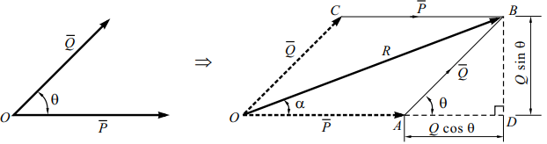
Composition of Forces
Based on the parallelogram law.
Fig. 8 Law of parallelogram of force^{[2]}

Slide 20
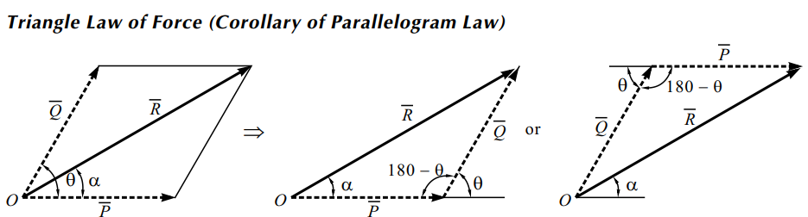
Composition of Forces
Based on the parallelogram law.
Fig. 9 Triangle law of forces (Corollary of parallelogram of force)^{[2]}

Slide 21
Fig. 2 Classification of Force system

Slide 22
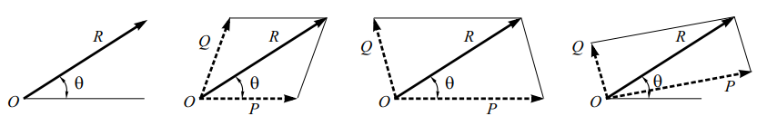
Resolution of Forces: Into oblique components of forces
The process of breaking the force into a number of components which are equivalent to the given forces is called resolution of force.
The law of parallelogram shows how to combine the forces into a resultant force whereas resolution of force is an inverse operation in which a given force is replaced by two components which are equivalent to the given force.
Fig. 11 Resolution of force into oblique components of force ^{[2]}

Slide 23
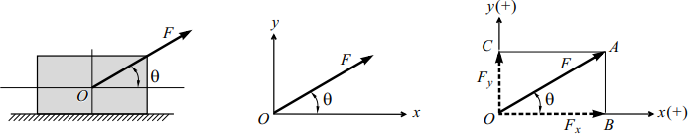
Resolution of Forces: Into Rectangular coordinates
The process of breaking the force into mutually perpendicular components, which are equivalent to the given force, is called rectangular components of force.
Fig. 12 Resolution of force into perpendicular components of force ^{[2]}

Slide 24
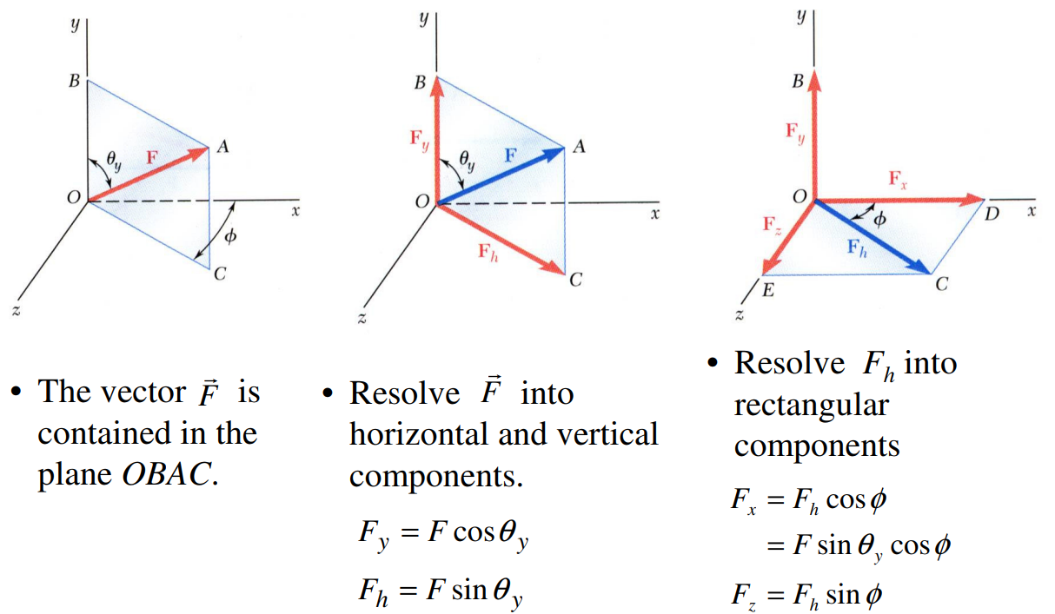
Resolution of Forces: in to Rectangular coordinates

Slide 25
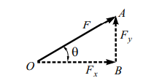
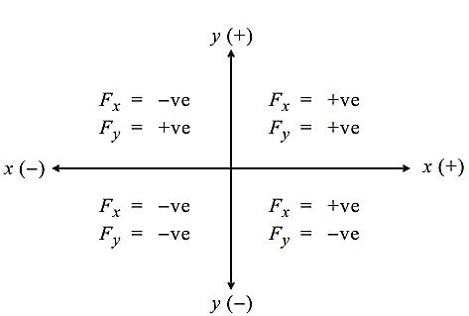
Resolution of Forces: Into Rectangular coordinates
The process of breaking the force into mutually perpendicular components, which are equivalent to the given force, is called rectangular components of force.
Sign Convention:
Fig. 12 Resolution of force into perpendicular components of force ^{[2]}

Slide 26
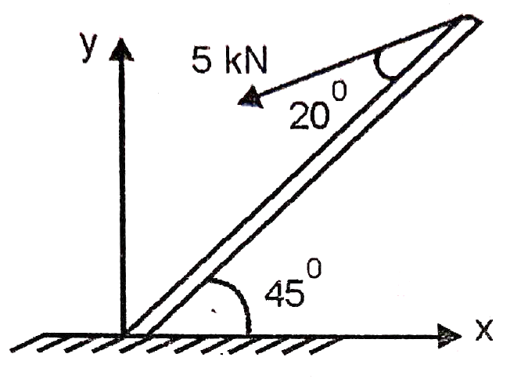
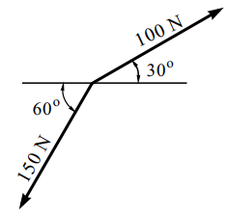
Numerical on Composition of Forces
Q. 1
Fig.10 Numerical^{[2]}

Slide 27
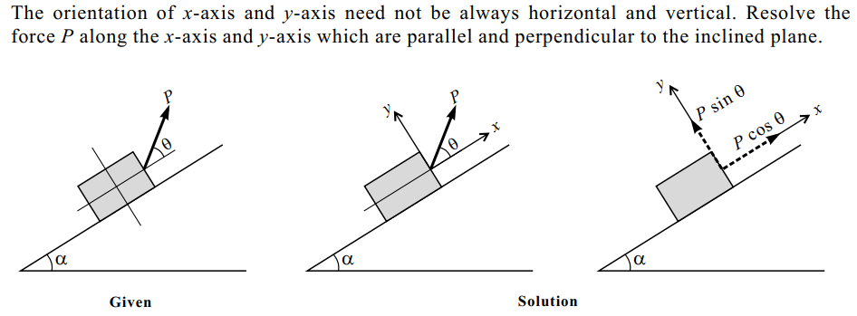
Resolution of Forces (Numericals)
Q. 2
Fig. 13 Moment of force ^{[2]}

Slide 28
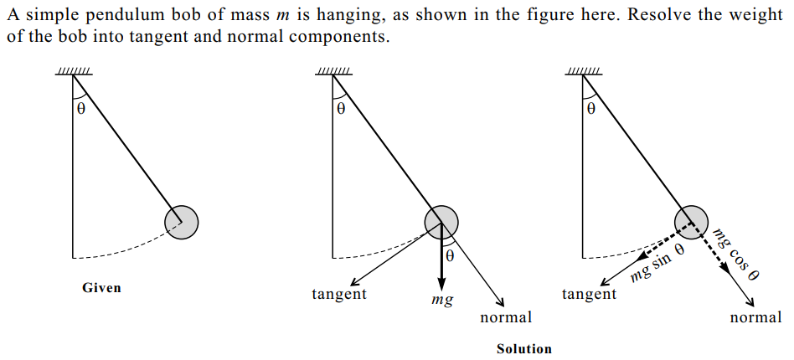
Resolution of Forces(Numericals)
Q. 3
Fig. 14 Moment of force ^{[2]}

Slide 29
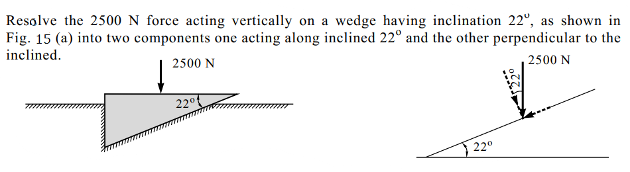
Resolution of Forces (Numericals)
Q. 4
(a)
Fig. 15 Moment of force ^{[2]}

Slide 30
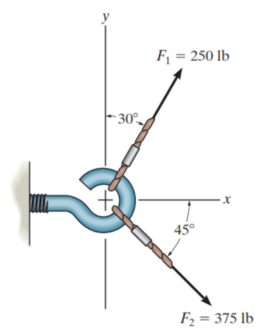
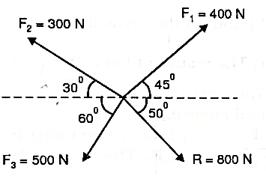
Resolution of Forces (Numericals)
Q. 5 Find the Fouth force(F4) R=800 N is the resultent of 4 concurrent forces.

Slide 31
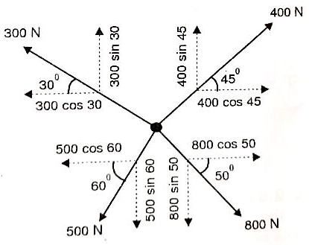
Resolution of Forces (Numericals)
Q. 6

Slide 32
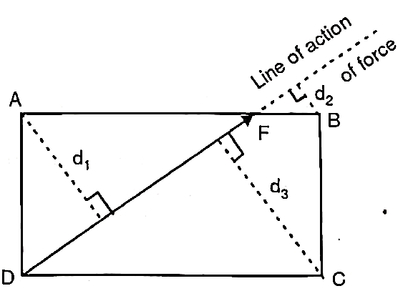
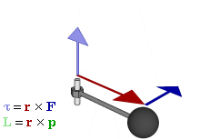
Moment of Force
The rotational effect of forces is
called as moment of force.
Rotational effect has to be
with respect to a point.
The concerned point is known as
the moment centre
This perpendicular distance is known as moment of arm
Fig. 16 Moments of force ^{[2]}

Slide 33
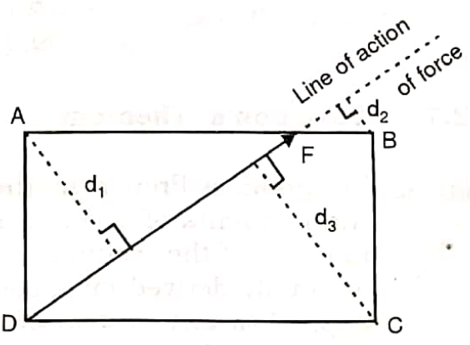
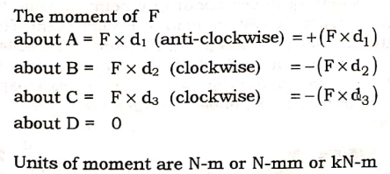

Moment of Force
Rotational effect or moment of force : Product of force and the perpendicular distance from moment centre to the force
Tendency to rotate clockwise or anti-clockwise
$$M=F×d$$
Fig. 16 Moments of force ^{[2]}

Slide 34
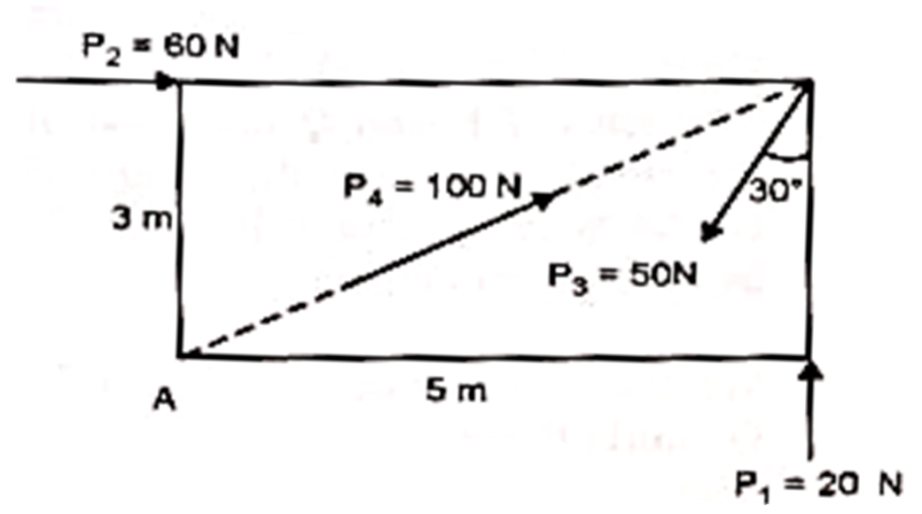
Q. 7 Find the resultant moment of all the forces about A

Slide 35
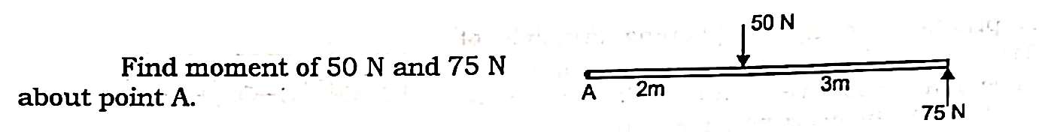
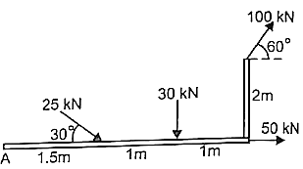
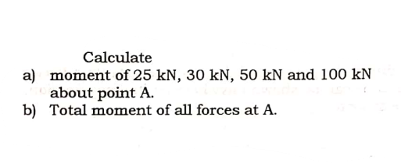
Moment of Force (Numericals)
Q. 8
Ans: 275N
Fig. 17
Q. 9
Fig. 18
Fig. 17,18 Moment of force ^{[3]}

Slide 36
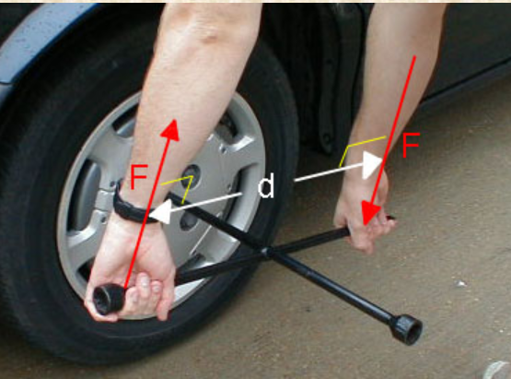
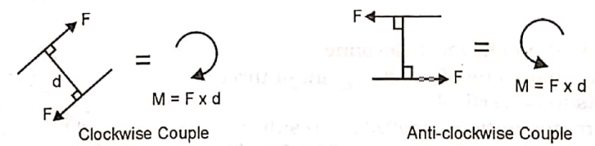
Couple
Two parallel forces of equal magnitude and opposite senses form a couple.
Effect: Rotate a body on which it acts.
Moment of Couple:
M = F X d
Sign convention:
Anticlockwise : + Ve
Clockwise: - Ve
Fig. 19 Fig. 20
Fig. 19,20 Couple ^{[3]}

Slide 37
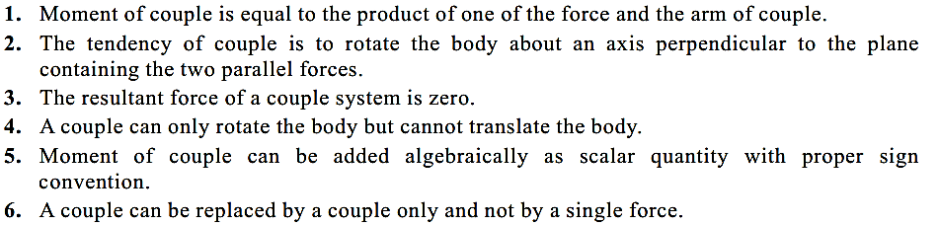
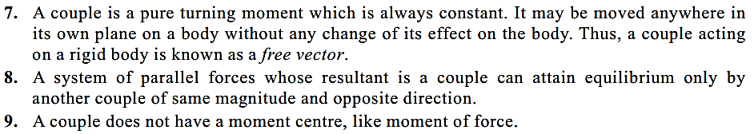
Properties Couple

Slide 38
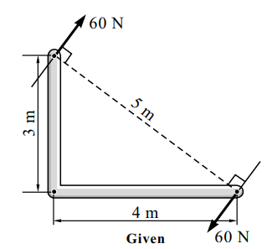
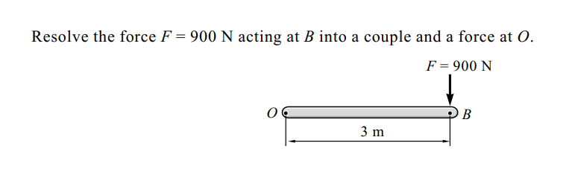
Couple (Numerical)
Q. 10
Calculate the couple
Fig. 21
Q. 11
Fig. 22
Fig. 21,22 Couple ^{[2]}

Slide 39
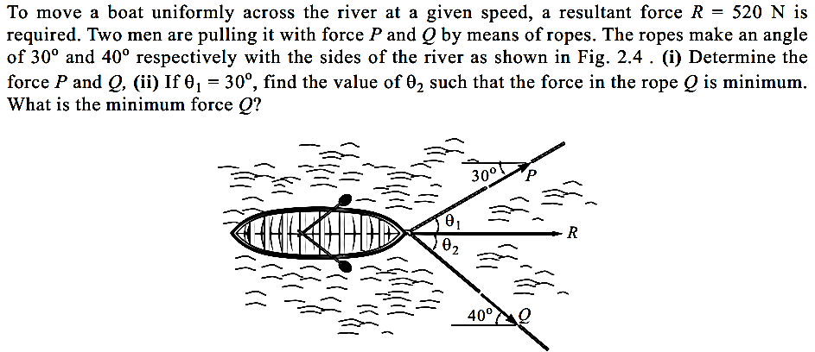
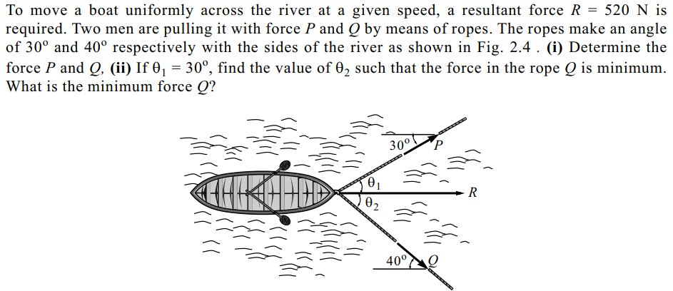
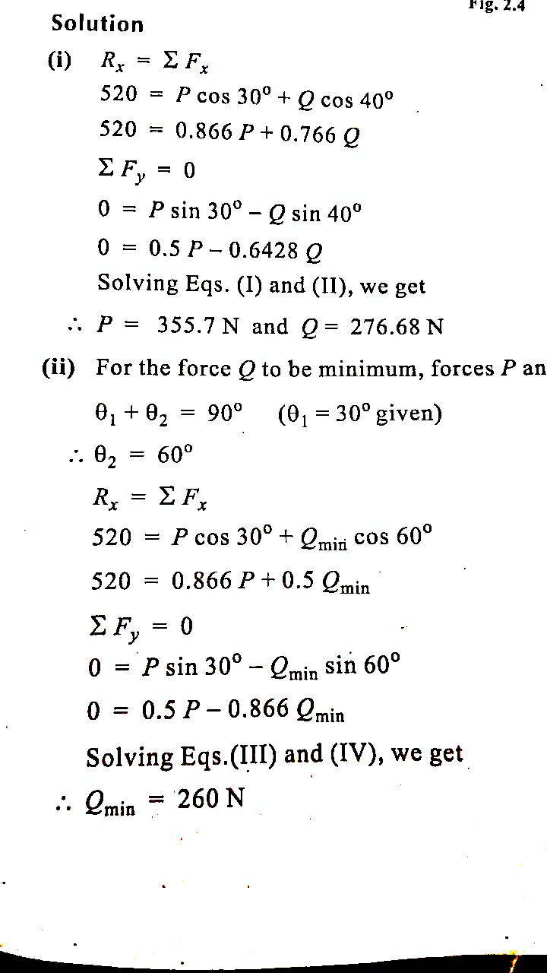
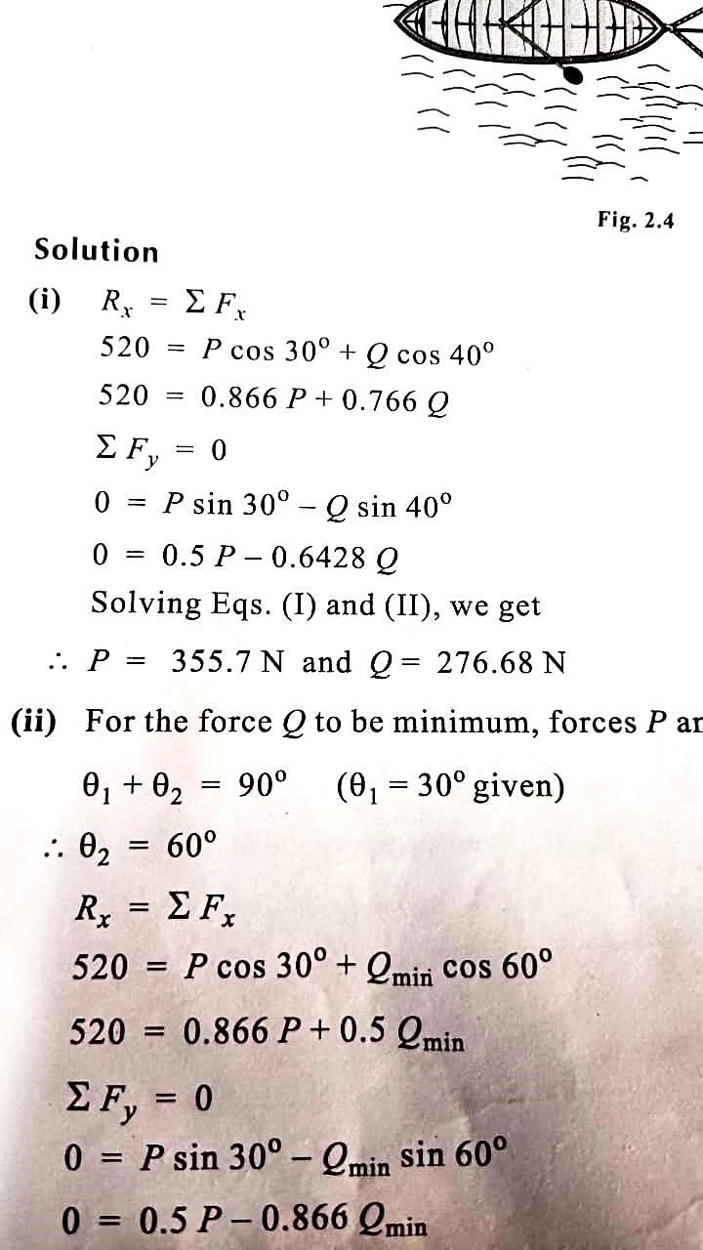
Resolution of Concurrent Forces (Numerical)
Q. 13

Slide 40
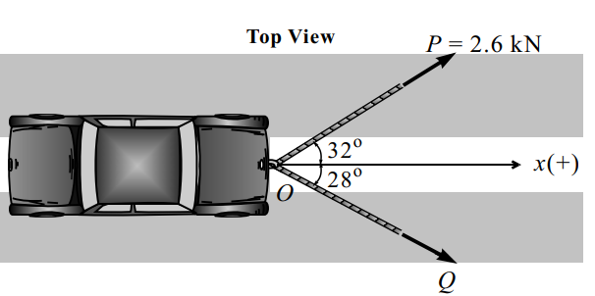
Resolution of Concurrent Forces (Numerical)
A car is pulled by means of two ropes as shown in Fig. 24. The tension in one rope is P = 2.6 kN. If the resultant of two forces applied at O is directed along the x-axis of the car. Find the tension in the other rope and magnitude of the resultant. (Q = 2.934 kN, R = 4.8 kN ( )
Q. 12
Fig. 24 Resultant of concurrent Forces ^{[2]}

Slide 41
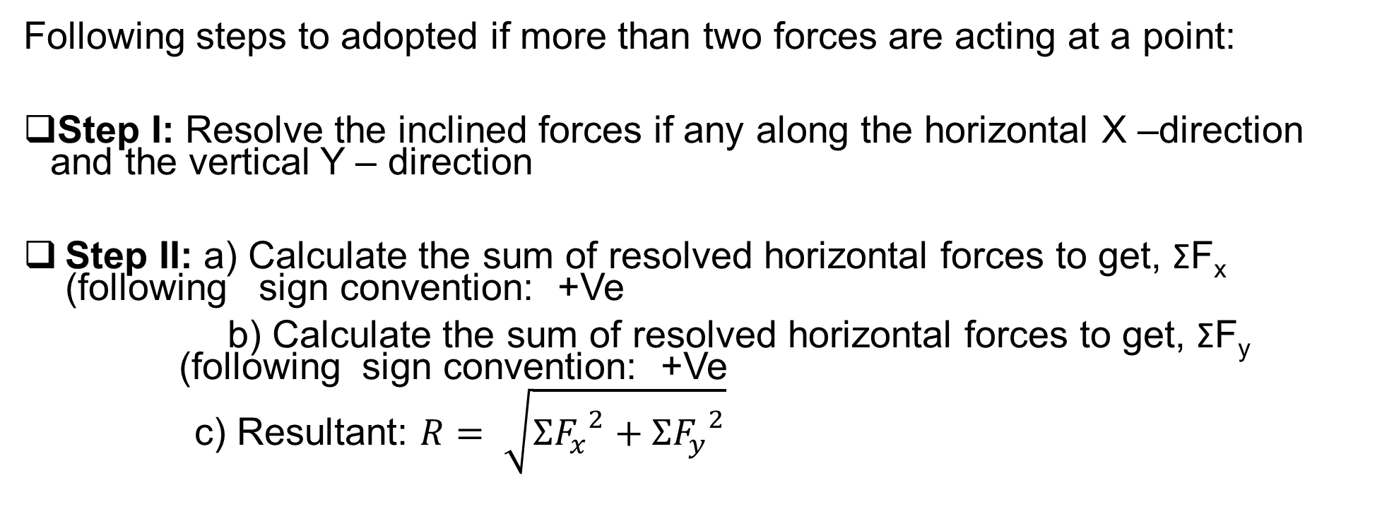
Resultant of Concurrent Forces Using Method of Resolution
Following steps to adopted if more than two forces are acting at a point:
Step I: Resolve the inclined forces if any along the horizontal X –direction and the vertical Y – direction
Step II: a) Calculate the sum of resolved horizontal forces to get, ΣF_{x} (following sign convention: +Ve
b) Calculate the sum of resolved horizontal forces to get, ΣF_{y} (following sign convention: +Ve
c) Resultant: $R= \sqrt{{{ΣF}_{x}^{}}^{2}+{{ΣF}_{y}^{}}^{2}}$

Slide 42
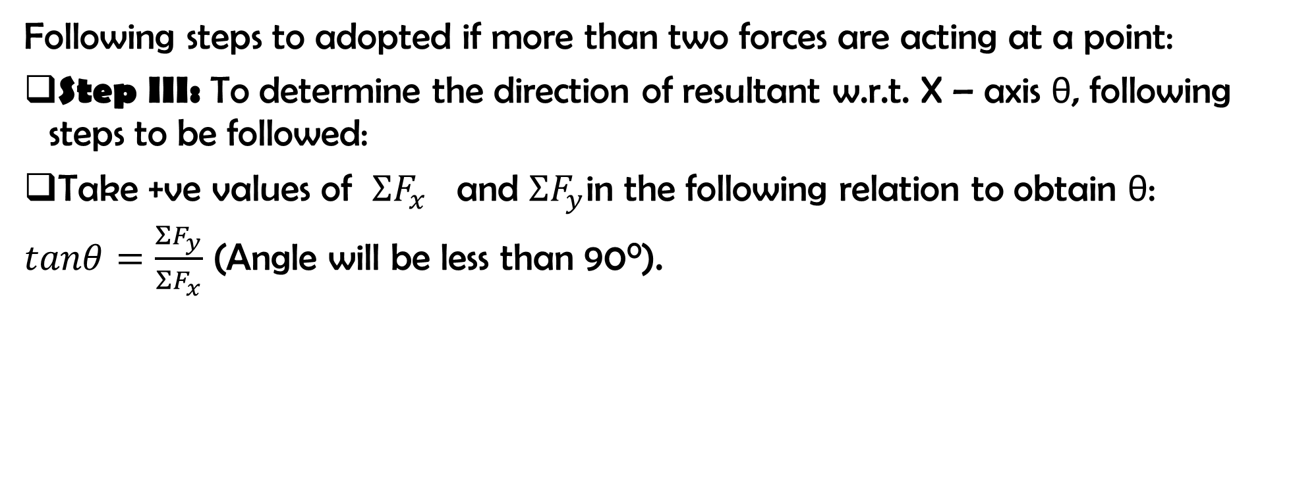
Resultant of Concurrent Forces Using Method of Resolution
Following steps to adopted if more than two forces are acting at a point:
Step III: To determine the direction of resultant w.r.t. X – axis θ, following steps to be followed:
Take +ve values of ${ΣF}_{x}^{}$ and ${ΣF}_{y}^{}$in the following relation to obtain θ:
$tanθ=\frac{{ΣF}_{y}^{}}{{ΣF}_{x}^{}}$ (Angle will be less than 90⁰).

Slide 43


Resultant of Concurrent Forces Using Method of Resolution
Following steps to adopted if more than two forces are acting at a point:
Step IV: Based on the $signs {ΣF}_{x}^{}$ of ${ΣF}_{y}^{}$ decide the quadrant of the resultant.
Step V: Draw the diagram showing the direction of the resultant.
Condition | Position of Resultant
${ΣF}_{x}^{}$ + Ve and ${ΣF}_{y}^{}$ + Ve | 1st Quadrant
${ΣF}_{x}^{}$ - Ve and ${ΣF}_{y}^{}$ + Ve | 2nd Quadrant
${ΣF}_{x}^{}$ - Ve and ${ΣF}_{y}^{}$ - Ve | 3rd Quadrant
${ΣF}_{x}^{}$ + Ve and ${ΣF}_{y}^{}$ - Ve | 4th Quadrant

Slide 44

Resolution of Concurrent Forces (Numerical)
Q. 14
Fig. 26 Resultant of concurrent Forces ^{[2]}

Slide 45

Resolution of Concurrent Forces (Numerical)
Q.15. Forces 7 kN, 10 kN, 10 kN and 3 kN, respectively act at one of the angular point of regular pentagon toward the other four points taken in order. Find their resultant completely.
(R = 25.10 kN, θ = 45.69⁰)
Fig. 26
Fig. 27 Resultant of concurrent Forces ^{[2]}

Slide 46



Resolution of Concurrent Forces (Numerical)
Q. 16

Slide 47


Couple (Numerical)
Q. 17
Fig. 23 Couple ^{[3]}

Slide 48


Numerical on Coplanar Parallel Forces
Q. 18 Determine the resultant of Force system shown in Fig. 29
Fig. 29
Fig. 29 Coplanar parallel Forces ^{[2]}

Slide 49



Q. 19

Slide 50

Numerical on Coplanar Parallel Forces
Q. 20 Fig. 30 shows four parallel forces acting on a beam ABCD.
Determine the resultant of the system and its location from A.
Replace the system by a single force and a couple acting at point B.
Replace the system by a single force and couple acting at point D>
Fig. 30

Slide 51

Q. 21 Fig. shows a parallel system of four forces and two couples.
Replace the system by a single force and obtain its location from A
Replace the system by a force couple system at point A.
Replace it by a force couple system at point D

Slide 52


Varignon’s Theorem
It states that
Moment of the resultant of all the forces in plane about any point is equal to the algebraic sum of moments of all the forces about the same point.
Fig. 28 Varignon’s Theorem ^{[2],[3]}

Slide 53

Varignon’s Theorem
Fig. 28 Varignon’s Theorem ^{[2],[3]}

Slide 54




Q. 22 Determine the resultant of the parallel Force system and locate it w.r.t. to O, if its radius is 1 m.

Slide 55

Numerical on Coplanar Non Concurrent – Non Parallel Forces
Q. 23 A triangular plate ABC is subjected to four coplanar forces as shown in Fig. 34. Determine the resultant completely and locate its position w.r.t. point A.
Fig. 34
Fig. 34 Coplanar Non Concurrent Non - Parallel Forces^{[2]}

Slide 56



Slide 57



Slide 58




Q. 24 Determine the resultant of the forces system shown in fig and
position where the resultant cuts the X axis

Slide 59


Slide 60

Numerical on Coplanar Non Concurrent – Non Parallel Forces
Q. 25 A system of forces of acting on a bell crank lever is shown in Fig.
Determine the magnitude, direction and the point of application of the resultant w.r.t ‘O’. Also determine the location of the resultant on the horizontal arm of the lever. (R = 2671.2 N at theta = 80.3 at perpendicular distance d = 139.17 mm to left of O. X = 14.12 cm left of O
Fig. 35
Fig. 35 Coplanar Non Concurrent Non - Parallel Forces^{[3]}

Slide 61



Slide 62


Q. 26 Determine the resultant of the given coplanar system of forces and a couple.
Also locate the resultant on the X axis w.r.t the origin.
Reduce the system to a force couple system at O.
This is a general force system, since the lines of action of all forces don‟t meet
at a single point.
Calculations of angles:
Fig. 37 Coplanar Non Concurrent Non - Parallel Forces^{[3]}

Slide 63




Magnitude of the resultant
Direction of the resultant

Slide 64



Slide 65

Q. 27 Three forces 1 kN, 3 KN and 2.5 kN act on a vertical pole 6 m high.
Determine:
The magnitude, direction and position of resultant w.r.t. A.
The position where the pole cuts the pole from the base.
Reduce it to a force couple system at A.
Fig. 36

Slide 66
Reference
https://commons.wikimedia.org/wiki/File:Thrust-force-simple.svg
‘Engineering Mechanics’, N.H. Dubey, Tata McGraw Hill Publication, 2017, page no: 1.1 to 1.25
‘Engineering Mechanics’, M.D. Dayal, page no: 14,24

Slide 67


